Slide 1
Lecture: Object Recognition
Juan Carlos Niebles and Ranjay Krishna
Stanford Vision and Learning Lab

Slide 2
What we will learn today?
Introduction to object recognition
K-nearest neighbor algorithm
A simple Object Recognition pipeline

Slide 3
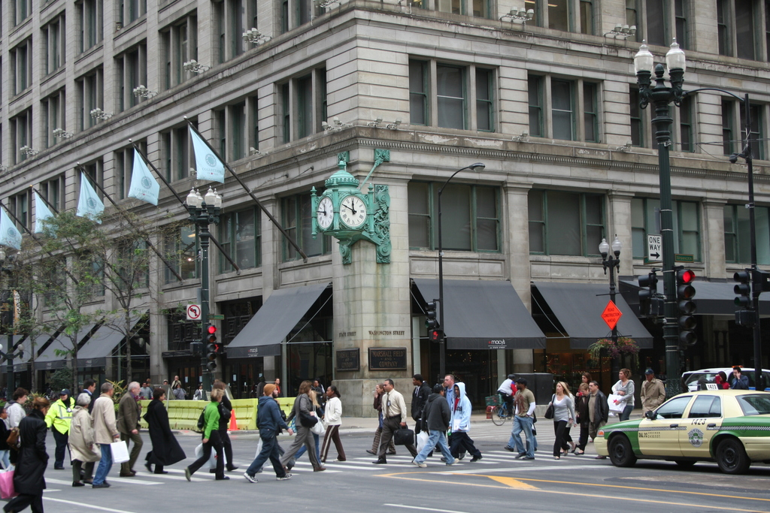
What are the different visual recognition tasks?
Notes:
Let’s give a look at this picture. It’s very easy for use to recognize the content of this picture. This is an urban scene. There is a building, a car, pedestrians and a clock. It would be great if we could design an artificial visual system that mimic human capabilities.
Specifically, what are the tasks we would like such a system to perform?

Slide 4
Classification:
Does this image contain a building? [yes/no]
Yes!

Slide 5
Classification:
Is this an beach?

Slide 6
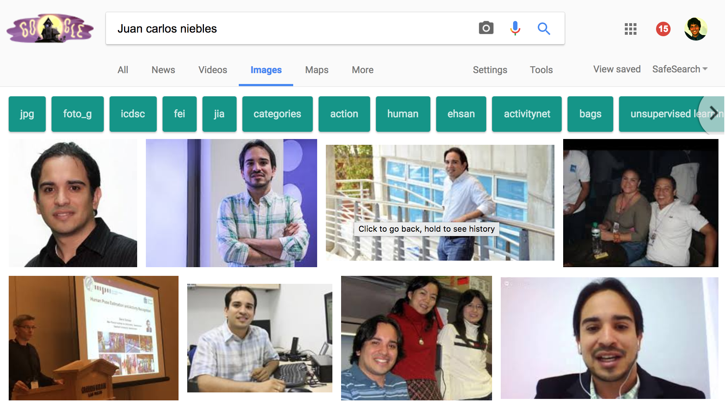
Image search

Slide 7
Image Search
Organizing photo collections

Slide 8
Detection:
Does this image contain a car? [where?]
car

Slide 9
Detection:
Which object does this image contain? [where?]
Building
clock
person
car

Slide 10
Detection:
Accurate localization (segmentation)
clock

Slide 11
Detection: Estimating object semantic & geometric attributes
Object: Building, 45º pose,
8-10 meters away
It has bricks
Object: Person, back;
1-2 meters away
Object: Police car, side view, 4-5 m away
Notes:
If we have an autonomouse vehicle, we would need to recognize that is object is a building, estimate its pose: 45 degree, 5-6 meters away, we would need to tell that this car is the the police car, 2-3 meters away, that is waiting for the traffic light to become green., that there are people on the street; these people are infact crossing the street.

Slide 12
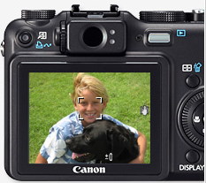
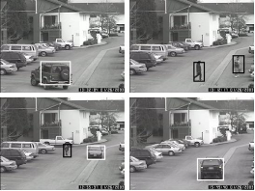
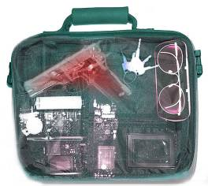
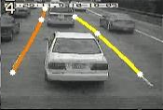
Applications of computer vision
Assistive technologies
Surveillance
Computational photography
Security
Assistive driving

Slide 13
Categorization vs Single instance recognition
Does this image contain the Chicago Macy’s building?

Slide 14
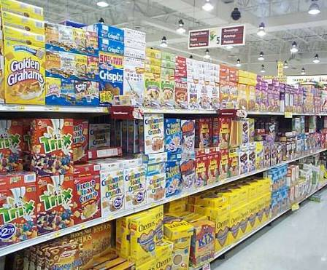
Categorization vs Single instance recognition
Where is the crunchy nut?

Slide 15
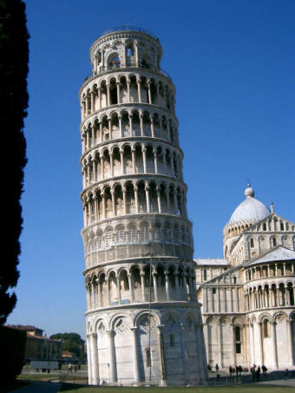
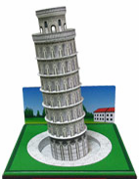
Applications of computer vision
Recognizing landmarks in mobile platforms
+ GPS
Notes:
This technology has become mature enough so that several applications are now taking advantage of these results.
this device takes can help the user recognize that the building is not pisa tower

Slide 16
Activity or Event recognition
What are these people doing?
Notes:
this device can perform 3D image recording of a face and use it as a password in protected enty points.
The system could be employed at airports or border crossings where a 3-D security camera could scan passengers' faces and compare them with a database of three-dimensional pictures of suspected criminals or terrorists, the twins said.

Slide 17
Visual Recognition
Design algorithms that have the capability to:
Classify images or videos
Detect and localize objects
Estimate semantic and geometrical attributes
Classify human activities and events
Why is this challenging?

Slide 18
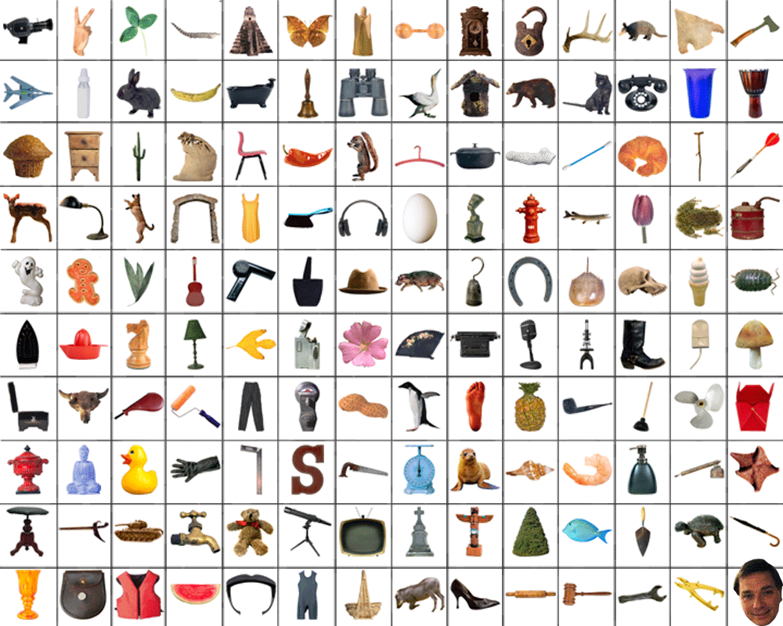
How many object categories are there?
~10,000 to 30,000

Slide 19
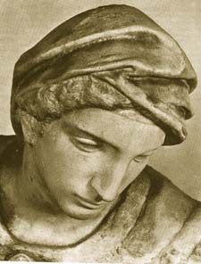
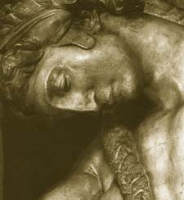
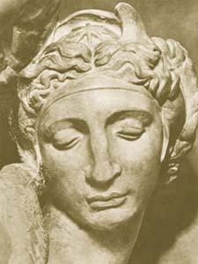
Challenges: viewpoint variation
Michelangelo 1475-1564

Slide 20
Challenges: illumination
image credit: J. Koenderink

Slide 21
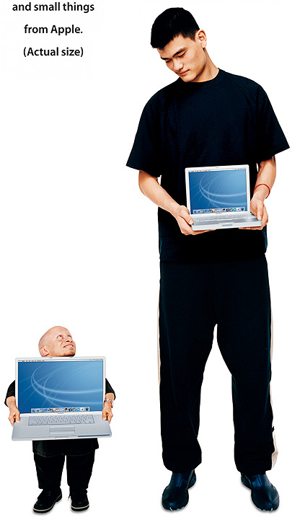
Challenges: scale

Slide 22
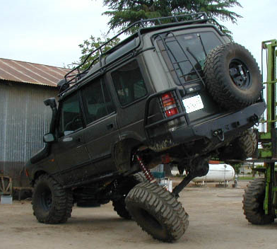
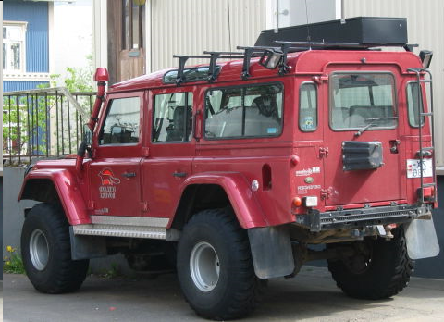
Challenges: deformation

Slide 23
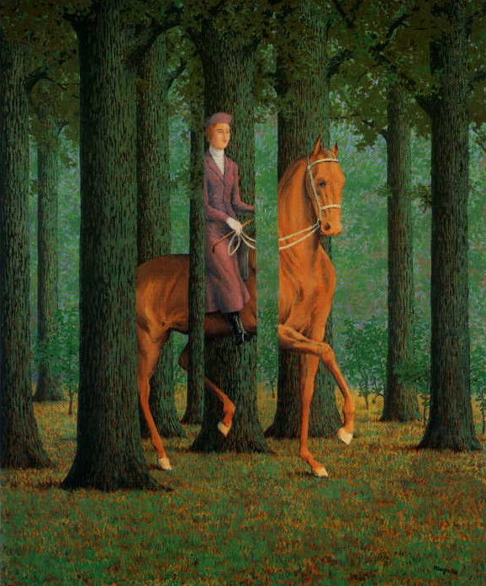
Challenges:
occlusion
Magritte, 1957

Slide 24
Art Segway - Magritte

Slide 25
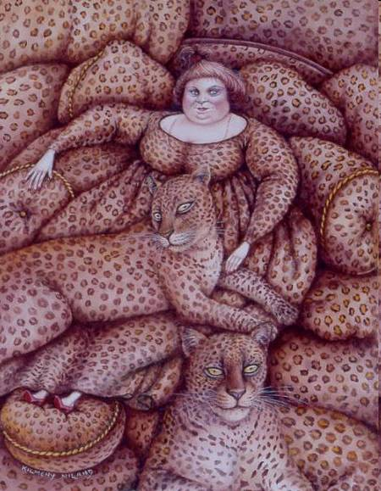
Challenges: background clutter
Kilmeny Niland. 1995

Slide 26
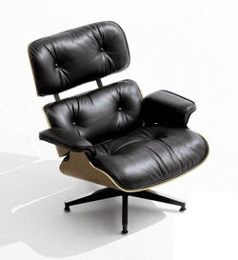
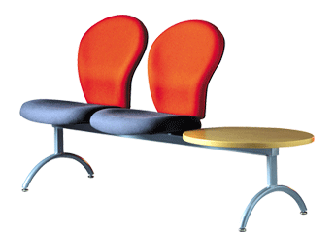
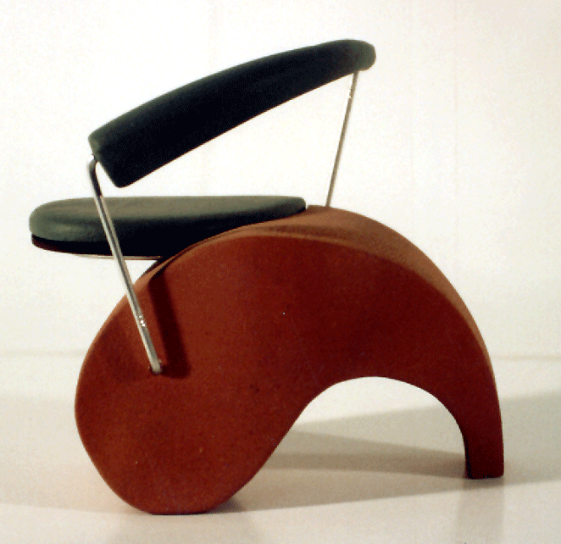
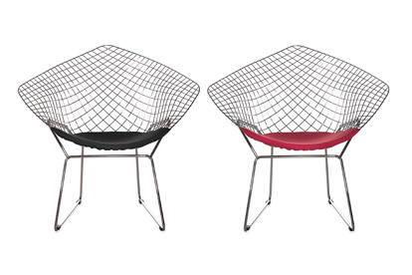
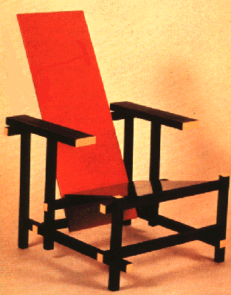
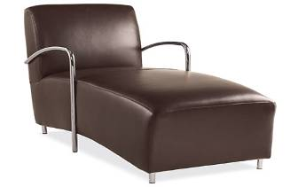
Challenges: intra-class variation

Slide 27
What we will learn today?
Introduction
K-nearest neighbor algorithm
A simple Object Recognition pipeline

Slide 28
The machine learning framework
y = f(x)
Training: given a training set of labeled examples {(x₁,y₁), …, (x_{N},y_{N})}, estimate the prediction function f by minimizing the prediction error on the training set
Testing: apply f to a never before seen test example x and output the predicted value y = f(x)
output
prediction function
Image feature
Slide credit: L. Lazebnik

Slide 29
Classification
Assign input vector to one of two or more classes
Any decision rule divides input space into decision regions separated by decision boundaries
Slide credit: L. Lazebnik

Slide 30
Nearest Neighbor Classifier
Assign label of nearest training data point to each test data point
Compute Distance
Test image
Training images
Choose k of the “nearest” records
Source: N. Goyal

Slide 31
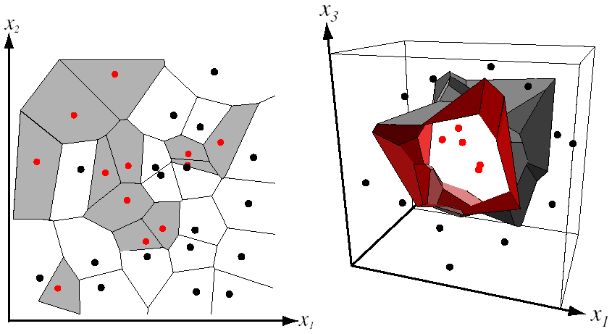
Nearest Neighbor Classifier
Assign label of nearest training data point to each test data point
from Duda et al.
partitioning of feature space
for two-category 2D and 3D data
Source: D. Lowe

Slide 32
K-nearest neighbor
Distance measure - Euclidean
x
x
x
o
x
x
x
+
o
o
x
x
o
o
Where X^{n} and X^{m} are the n-th and m-th data points
o
o
x2
x1

Slide 33
1-nearest neighbor
Distance measure - Euclidean
x
x
x
o
x
x
x
+
o
o
x
x
o
o
Where X^{n} and X^{m} are the n-th and m-th data points
o
o
x2
x1

Slide 34
3-nearest neighbor
Distance measure - Euclidean
x
x
x
o
x
x
x
+
o
o
x
x
o
o
Where X^{n} and X^{m} are the n-th and m-th data points
o
o
x2
x1

Slide 35
5-nearest neighbor
Distance measure - Euclidean
x
x
x
o
x
x
x
+
o
o
x
x
o
o
Where X^{n} and X^{m} are the n-th and m-th data points
o
o
x2
x1

Slide 36
K-NN: a very useful algorithm
Simple, a good one to try first
Very flexible decision boundaries
With infinite examples, 1-NN provably has error that is at most twice Bayes optimal error (out of scope for this class).

Slide 37
K-NN: issues to keep in mind
Choosing the value of k:
If too small, sensitive to noise points
If too large, neighborhood may include points from other classes

Slide 38
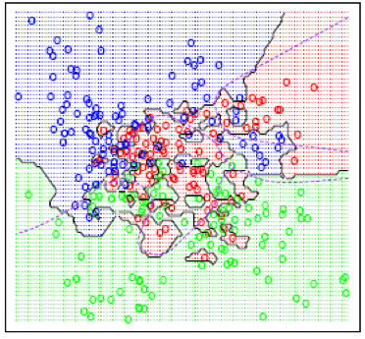
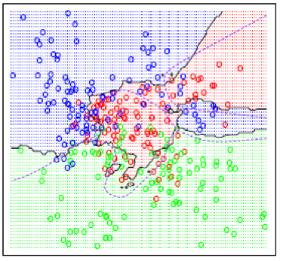
K-NN: issues to keep in mind
Choosing the value of k:
If too small, sensitive to noise points
If too large, neighborhood may include points from other classes
K=1
K=15

Slide 39
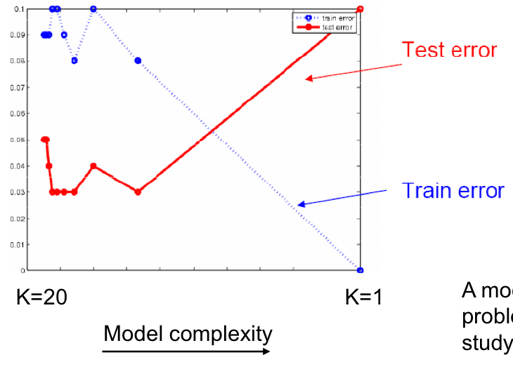
K-NN: issues to keep in mind
Choosing the value of k:
If too small, sensitive to noise points
If too large, neighborhood may include points from other classes
Solution: cross validate!

Slide 40
Cross validation

Slide 41
K-NN: issues to keep in mind
Choosing the value of k:
If too small, sensitive to noise points
If too large, neighborhood may include points from other classes
Solution: cross validate!
Can produce counter-intuitive results (using Euclidean measure)

Slide 42
Euclidean measure
1 1 1 1 1 1 1 1 1 1 1 0
1 0 0 0 0 0 0 0 0 0 0 0
vs
0 1 1 1 1 1 1 1 1 1 1 1
0 0 0 0 0 0 0 0 0 0 0 1
d = 1.4142
d = 1.4142

Slide 43
K-NN: issues to keep in mind
Choosing the value of k:
If too small, sensitive to noise points
If too large, neighborhood may include points from other classes
Solution: cross validate!
Can produce counter-intuitive results (using Euclidean measure)
Solution: normalize the vectors to unit length

Slide 44
K-NN: issues to keep in mind
Choosing the value of k:
If too small, sensitive to noise points
If too large, neighborhood may include points from other classes
Solution: cross validate!
Can produce counter-intuitive results (using Euclidean measure)
Solution: normalize the vectors to unit length
Curse of Dimensionality

Slide 45
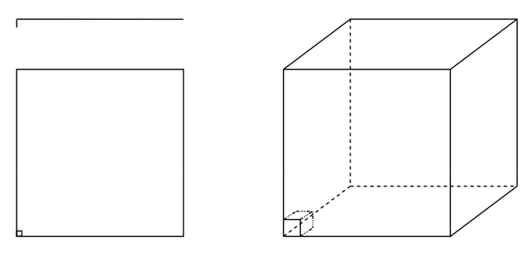
Curse of dimensionality
Assume 5000 points uniformly distributed in the unit hypercube and we want to apply 5-NN. Suppose our query point is at the origin.
In 1-dimension, we must go a distance of 5/5000=0.001 on the average to capture 5 nearest neighbors.
In 2 dimensions, we must go to get a square that contains 0.001 of the volume.
In d dimensions, we must go

Slide 46
K-NN: issues to keep in mind
Choosing the value of k:
If too small, sensitive to noise points
If too large, neighborhood may include points from other classes
Solution: cross validate!
Can produce counter-intuitive results (using Euclidean measure)
Solution: normalize the vectors to unit length
Curse of Dimensionality
Solution: no good one

Slide 47
Many classifiers to choose from
K-nearest neighbor
SVM
Neural networks
Naïve Bayes
Bayesian network
Logistic regression
Randomized Forests
Boosted Decision Trees
RBMs
Etc.
Which is the best one?
Slide credit: D. Hoiem

Slide 48

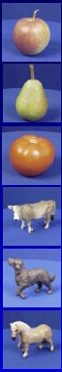
Generalization
Training set (labels known)
Test set (labels unknown)
How well does a learned model generalize from the data it was trained on to a new test set?
Slide credit: L. Lazebnik

Slide 49
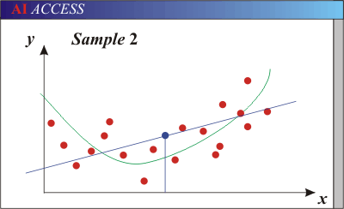
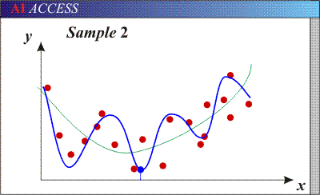
Bias-Variance Trade-off
Models with too few parameters are inaccurate because of a large bias (not enough flexibility).
Models with too many parameters are inaccurate because of a large variance (too much sensitivity to the sample).
Slide credit: D. Hoiem
Notes:
http://www.aiaccess.net/English/Glossaries/GlosMod/e_gm_bias_variance.htm

Slide 50
Bias versus variance
Components of generalization error
Bias: how much the average model over all training sets differ from the true model?
Error due to inaccurate assumptions/simplifications made by the model
Variance: how much models estimated from different training sets differ from each other
Underfitting: model is too “simple” to represent all the relevant class characteristics
High bias and low variance
High training error and high test error
Overfitting: model is too “complex” and fits irrelevant characteristics (noise) in the data
Low bias and high variance
Low training error and high test error
Slide credit: L. Lazebnik

Slide 51
Bias versus variance trade off

Slide 52
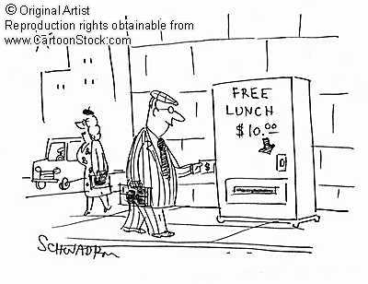
No Free Lunch Theorem
In a supervised learning setting, we can’t tell which classifier will have best generalization
Slide credit: D. Hoiem
Notes:
You can only get generalization through assumptions.

Slide 53
Remember…
No classifier is inherently better than any other: you need to make assumptions to generalize
Three kinds of error
Inherent: unavoidable
Bias: due to over-simplifications
Variance: due to inability to perfectly estimate parameters from limited data
Slide credit: D. Hoiem
Notes:
You can only get generalization through assumptions.

Slide 54
How to reduce variance?
Choose a simpler classifier
Regularize the parameters
Get more training data
How do you reduce bias?
Slide credit: D. Hoiem
Notes:
The simpler classifier or regularization could increase bias and lead to more error.

Slide 55
Last remarks about applying machine learning methods to object recognition
There are machine learning algorithms to choose from
Know your data:
How much supervision do you have?
How many training examples can you afford?
How noisy?
Know your goal (i.e. task):
Affects your choices of representation
Affects your choices of learning algorithms
Affects your choices of evaluation metrics
Understand the math behind each machine learning algorithm under consideration!

Slide 56
What we will learn today?
Introduction
K-nearest neighbor algorithm
A simple Object Recognition pipeline

Slide 57
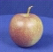
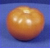
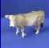
Object recognition: a classification framework
Apply a prediction function to a feature representation of the image to get the desired output:
f( ) = “apple”
f( ) = “tomato”
f( ) = “cow”
Dataset: ETH-80, by B. Leibe
Slide credit: L. Lazebnik

Slide 58
A simple pipeline - Training
Training Images
Image Features

Slide 59
A simple pipeline - Training
Training Labels
Training Images
Image Features
Training

Slide 60
A simple pipeline - Training
Training Labels
Training Images
Image Features
Training
Learned Classifier

Slide 61
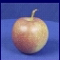
A simple pipeline - Training
Training Labels
Training Images
Image Features
Training
Learned Classifier
Test Image
Image Features

Slide 62
A simple pipeline - Training
Training Labels
Training Images
Image Features
Training
Learned Classifier
Test Image
Image Features
Learned Classifier
Prediction

Slide 63
A simple pipeline - Training
Training Labels
Training Images
Image Features
Training
Learned Classifier
Test Image
Image Features
Learned Classifier
Prediction

Slide 64
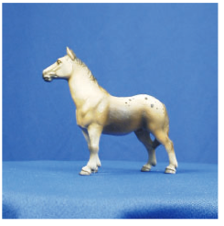
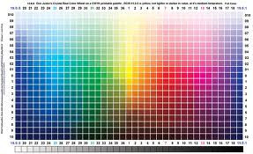
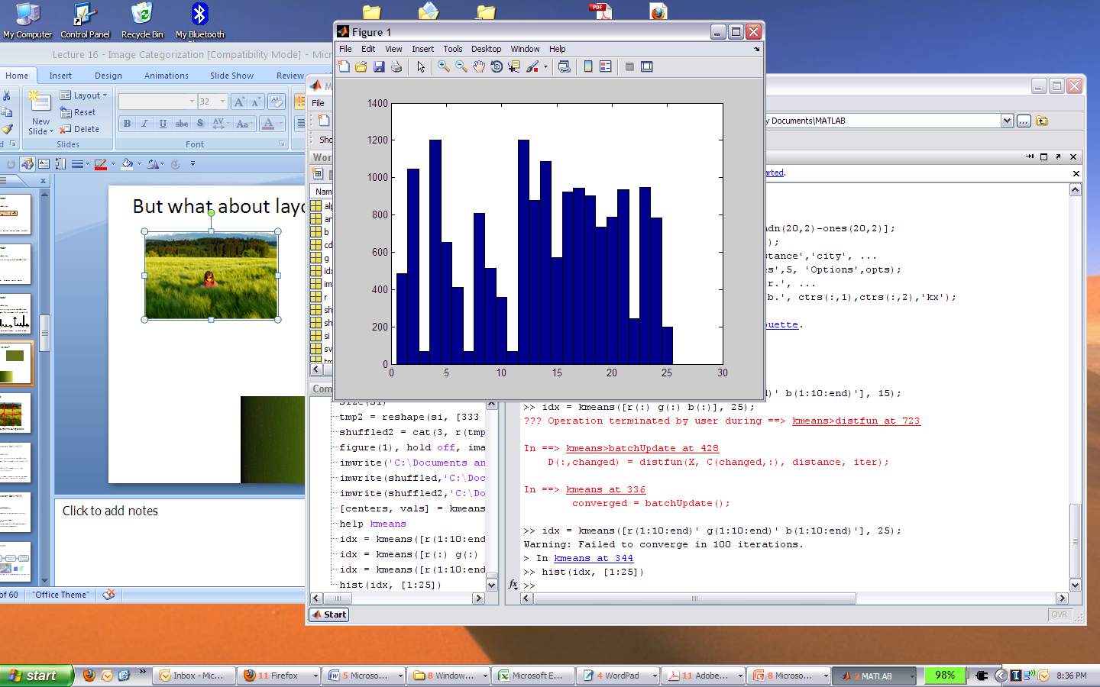
Image features
Input image
Color: Quantize RGB values
Invariance?
? Translation
? Scale
? Rotation
? Occlusion

Slide 65


Image features
Input image
Color: Quantize RGB values
Invariance?
? Translation
? Scale
? Rotation (in-planar)
? Occlusion

Slide 66

Image features
Input image
Color: Quantize RGB values
Invariance?
? Translation
? Scale
? Rotation (in-planar)
? Occlusion
Global shape: PCA space
Invariance?
? Translation
? Scale
? Rotation (in-planar)
? Occlusion

Slide 67
Image features
Input image
Color: Quantize RGB values
Invariance?
? Translation
? Scale
? Rotation (in-planar)
? Occlusion
Global shape: PCA space
Invariance?
? Translation
? Scale
? Rotation (in-planar)
? Occlusion

Slide 68
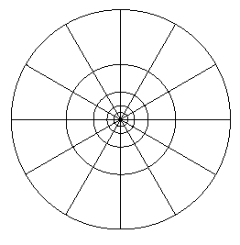
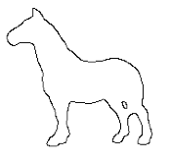
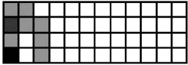
Image features
Input image
Color: Quantize RGB values
Invariance?
? Translation
? Scale
? Rotation
? Occlusion
Global shape: PCA space
Invariance?
? Translation
? Scale
? Rotation
? Occlusion
Local shape: shape context
Invariance?
? Translation
? Scale
? Rotation (in-planar)
? Occlusion

Slide 69
Image features
Input image
Color: Quantize RGB values
Invariance?
? Translation
? Scale
? Rotation
? Occlusion
Global shape: PCA space
Invariance?
? Translation
? Scale
? Rotation
? Occlusion
Local shape: shape context
Invariance?
? Translation
? Scale
? Rotation (in-planar)
? Occlusion

Slide 70
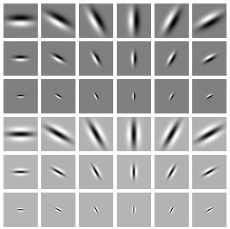
Image features
Input image
Color: Quantize RGB values
Invariance?
? Translation
? Scale
? Rotation
? Occlusion
Global shape: PCA space
Invariance?
? Translation
? Scale
? Rotation
? Occlusion
Local shape: shape context
Invariance?
? Translation
? Scale
? Rotation (in-planar)
? Occlusion
Texture: Filter banks
Invariance?
? Translation
? Scale
? Rotation (in-planar)
? Occlusion

Slide 71
Image features
Input image
Color: Quantize RGB values
Invariance?
? Translation
? Scale
? Rotation
? Occlusion
Global shape: PCA space
Invariance?
? Translation
? Scale
? Rotation
? Occlusion
Local shape: shape context
Invariance?
? Translation
? Scale
? Rotation (in-planar)
? Occlusion
Texture: Filter banks
Invariance?
? Translation
? Scale
? Rotation (in-planar)
? Occlusion

Slide 72
A simple pipeline - Training
Training Labels
Training Images
Image Features
Training
Learned Classifier
Test Image
Image Features
Learned Classifier
Prediction

Slide 73
Classifiers: Nearest neighbor
Training examples from class 2
Training examples from class 1
Slide credit: L. Lazebnik

Slide 74
A simple pipeline - Training
Training Labels
Training Images
Image Features
Training
Learned Classifier
Test Image
Image Features
Learned Classifier
Prediction

Slide 75
Classifiers: Nearest neighbor
Test example
Training examples from class 2
Training examples from class 1
Slide credit: L. Lazebnik

Slide 76
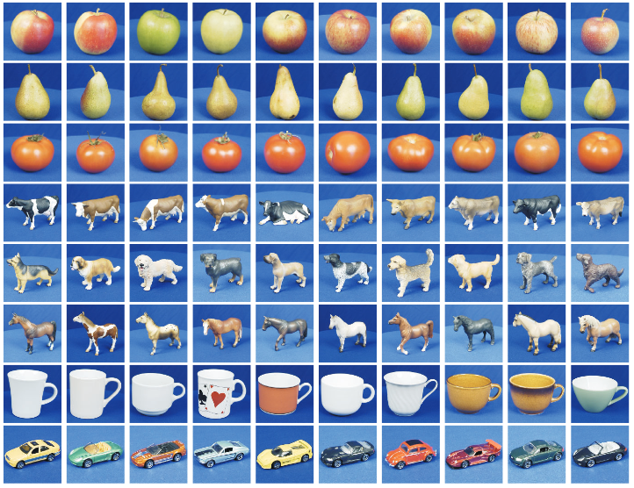
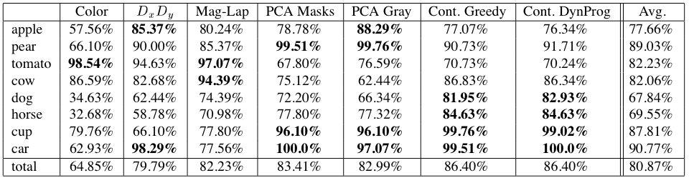
Results
Dataset: ETH-80, by B. Leibe, 2003

Slide 77
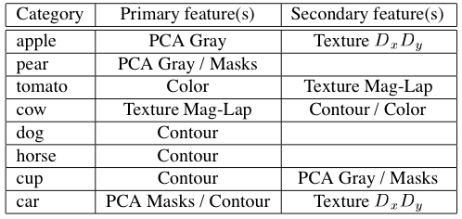
Results
Dataset: ETH-80, by B. Leibe, 2003

Slide 78
What we have learned today?
Introduction
K-nearest neighbor algorithm
A simple Object Recognition pipeline

